Slide 1



Indian Premier League Analysis
Business Intelligence & Data Warehousing
MSIS 2621
Project Group 6

Slide 2
Content
What is Indian Premier League?
Business Scenario
Swim Lane Diagram
Architecture Diagram
Data Model diagrams for all three databases
ETL Design Overview
ETL Mappings
Tableau Dashboard – Screenshots
Interactive demo Tableau
Key learnings from the Project

Slide 3
What is Indian Premier League(IPL)
Indian Premier League is a professional Twenty over cricket tournament in which players from 14 different countries play for different franchise.
IPL is the most attended cricket league in the world and ranked sixth for the most attended league in the world.
As of know more than 500 players have played in IPL by now.
Around 1.5 million balls have been bowled in IPL by now in more than 500 cricket matches.
We have collected the entire dataset for it and will present our analysis for the same.

Slide 4
Business Scenarios
Descriptive Analysis of each player.
Analysis of Toss Results based on Venue
Prescriptive Analysis for retention of Players
Predictive Analysis for the Auction

Slide 5
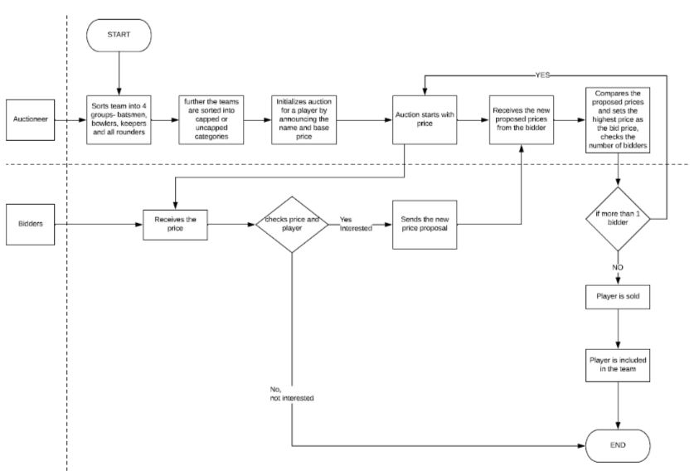
Swim Lane Diagram- Player Auction

Slide 6
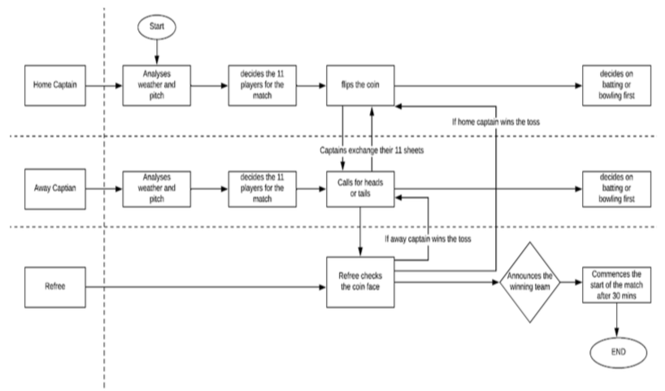
Swim Lane Diagram- Toss

Slide 7
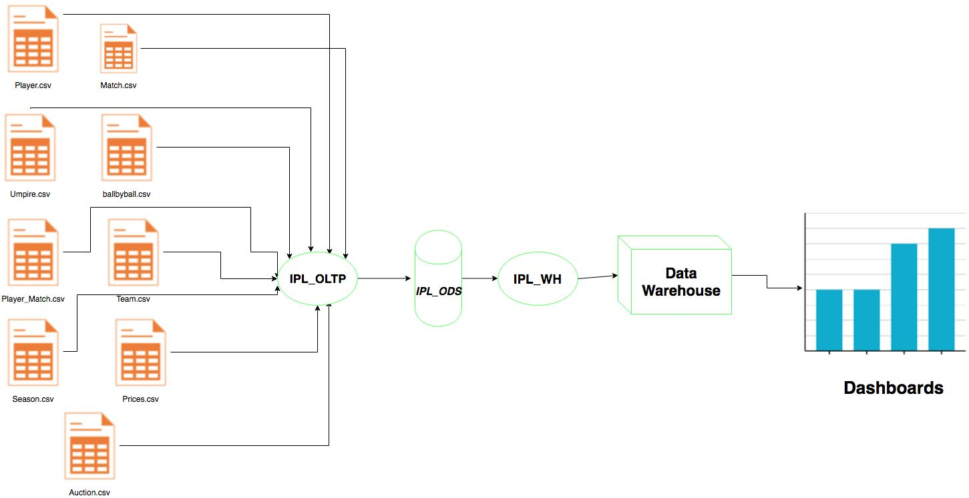
Architecture Diagram

Slide 8
Data Model Diagram for OLTP Database (IPL)

Slide 9
Data Model Diagram for ODS Database (IPL_ODS)

Slide 10
Data Model Diagram for Data Warehouse (IPL_WH)

Slide 11
Overview of ETL Implementation
Took initial input files and loaded Data from CSV and Excel files into our database
Designed an ODS database by joining multiple tables and keeping only the essential attributes which were required to create the dimension table and fact table for the Analysis.
Designed a Data Warehouse were we loaded the dimension tables from the ODS database keeping in mind different dimensions and facts for the purpose of analysis.
Created a fact table inside the Warehouse where only facts which were to be shown in Tableau were stored.

Slide 12
ETL Mappings
Generating Input from the Excel Files to load into OLTP Database
Showing the creation of table named as “Team”

Slide 13
ETL Mappings
Generating the ODS tables from the OLTP database.
Used SQL queries which included various cases for different conditions.

Slide 14
ETL Mappings
Loading the Data Warehouse using multiple ODS tables.
Created various dimension tables and fact tables for the same.

Slide 15
Tableau Dashboard

Slide 16
Tableau Dashboard

Slide 17
Tableau Dashboard

Slide 18
Key Learnings from the Project
Learnt how to handle high volume and variety of data altogether.
Learnt how to use SQL queries along with the cases inside ETL tool.
We found that visualized data provided more insights than data represented in numeric and string form.
Swim Lane diagrams made it easier to understand the process as compared to directly generating the data model diagram for the same.

Slide 19
Thank You

